Slide 1

Advanced Wound Care Partnership: Maximizing Revenue & Improving Patient Outcomes
Chicago Medical Group Inc. offers specialized amniotic stem cell graft treatment for chronic wounds that haven't responded to conventional therapy within 30 days. Our partnership creates multiple revenue streams while enhancing patient care standards at your facility.

Slide 2
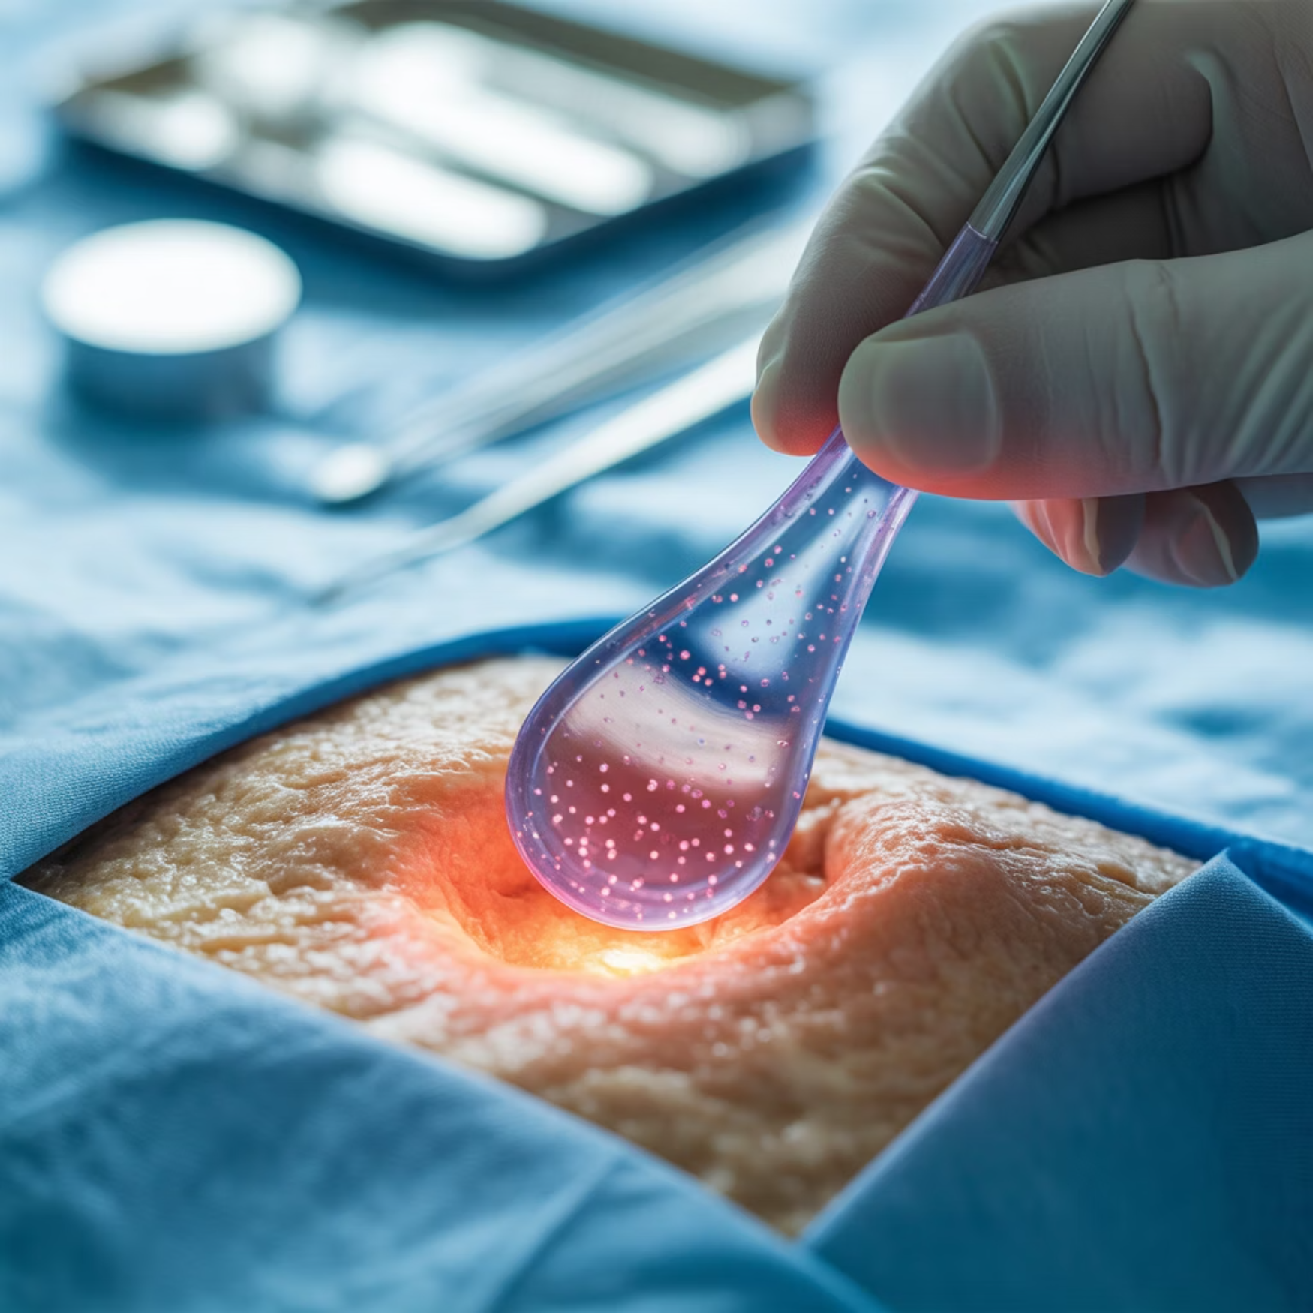
Understanding Our Specialized Approach
The Chronic Wound Challenge
Our Advanced Solution
Chronic wounds affect approximately 6.5 million patients in the U.S., with treatment costs exceeding $25 billion annually. These wounds significantly impact patient quality of life and facility resources.
CMG specializes in cutting-edge amniotic stem cell graft technology, providing treatment for difficult-to-heal wounds when traditional approaches fail.
Many facilities struggle with wounds that don't respond to conventional treatment, leading to extended stays, complications, and reduced reimbursement rates.
Direct Medicare Part B reimbursement
Three weekly on-site visits
Care provided exclusively by doctors and nurse practitioners

Slide 3
Financial Benefits for Your Facility
$10K
$120K
$0
100%
Monthly Revenue
Annual Income
Clinician Cost
Supply Coverage
Additional income from renting unused space at fair market value
Guaranteed yearly revenue from facility space rental
No facility expense for wound care specialists
All advanced wound care supplies provided by CMG
Our partnership creates immediate financial benefits while removing the burden of specialized wound care costs from your operational budget.

Slide 4
Operational Advantages
Enhanced Facility Utilization
Supply Management Simplified
Clinical Staffing Support
Transform unused space into revenue-generating areas without capital investment or staffing changes. Our team brings all necessary equipment and expertise.
Eliminate the need to purchase, store, and manage specialized wound care supplies. CMG handles all advanced wound care materials, reducing your inventory costs and storage requirements.
Our doctors and nurse practitioners supplement your existing care team without adding to your payroll. We provide specialized expertise that would otherwise be costly to maintain in-house.

Slide 5

Clinical Excellence & Patient Care
Comprehensive Care Model
Three weekly on-site visits ensure consistent monitoring
Regular rounds and wellness checks for all patients
Early intervention for developing wounds
Only doctors and nurse practitioners provide treatment
Our clinical team integrates seamlessly with your existing staff, providing specialized expertise while maintaining continuity of care for your residents.

Slide 6




Impact on Facility Ratings & Referrals
Improved Wound Healing
Higher Facility Ratings
Advanced treatment accelerates healing of chronic wounds that haven't responded to conventional care within 30 days
Better outcomes and reduced complications contribute to improved CMS quality measures and overall facility ratings
Increased Hospital Referrals
Revenue Growth
Hospitals prefer facilities with demonstrated excellence in wound care, leading to more patient referrals
Higher occupancy rates and improved reimbursement combine to significantly enhance facility revenue

Slide 7

Reducing Readmissions & Improving Compliance
Lower Hospital Readmission Rates
Enhanced Regulatory Compliance
Chronic wounds are a leading cause of hospital readmissions from long-term care facilities. Our specialized care significantly reduces these occurrences by:
Our documentation and treatment protocols align with current CMS guidelines and best practices, helping your facility maintain compliance with:
Preventing wound deterioration
F-tag requirements for skin integrity
Managing infections before they become severe
Quality measure reporting
Providing ongoing monitoring and early intervention
Treatment documentation standards
Facilities partnering with CMG have seen readmission rates for wound-related complications decrease by up to 40%.

Slide 8








Partner With Chicago Medical Group Today
Financial Benefits
Clinical Excellence
$10,000 monthly rental income, eliminated supply costs, and no clinician expenses
Cutting-edge amniotic stem cell technology delivered by qualified doctors and nurse practitioners
Enhanced Reputation
Better Outcomes
Higher facility ratings, increased referrals, and stronger positioning in your market
Improved healing rates, reduced complications, and enhanced quality of life for residents
Contact us to schedule a consultation and discover how our partnership can transform your facility's wound care program while significantly improving your bottom line.

